Slide 1
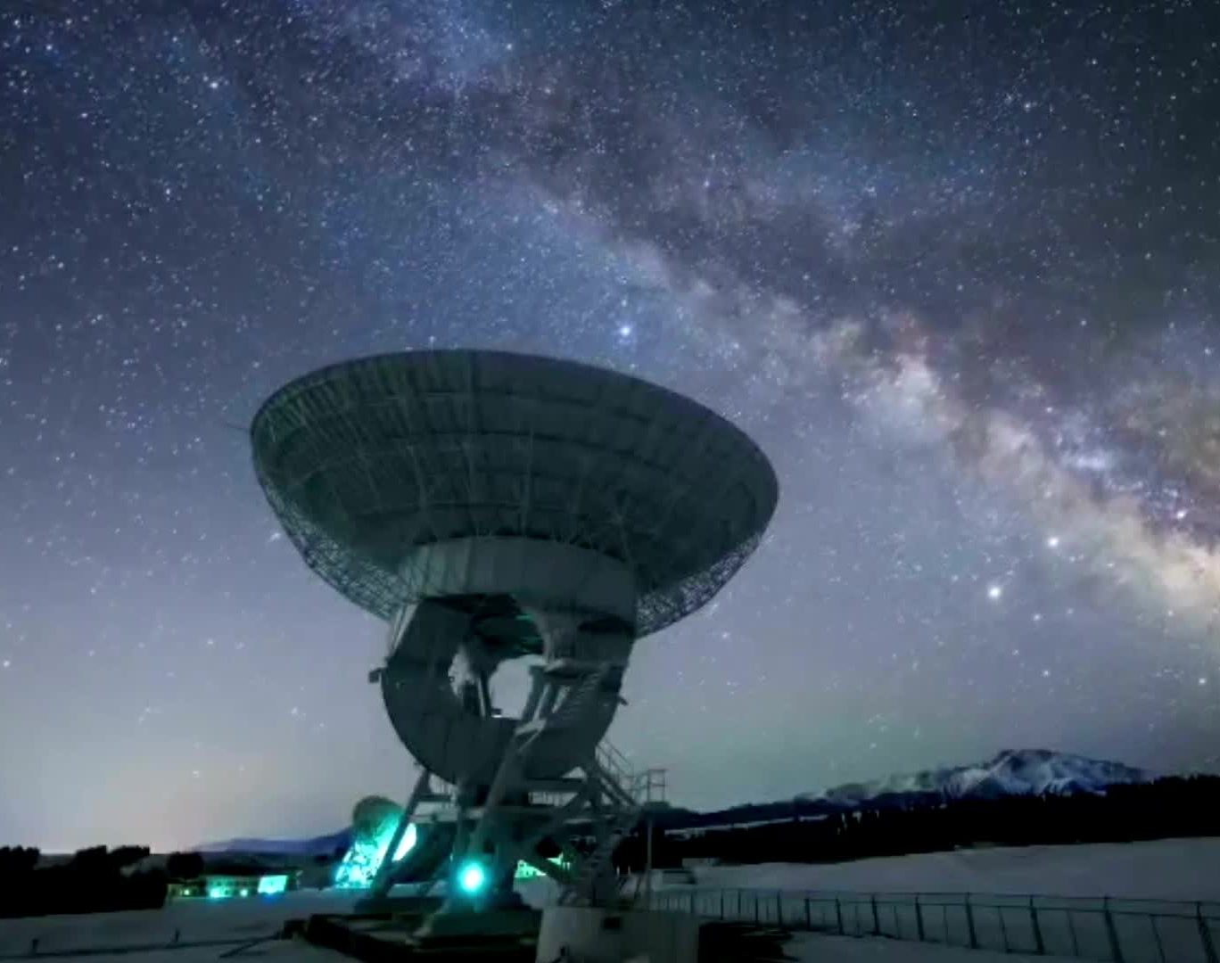
Winning the Space Race with Data Science
Karissa Mohr
4/10/2025

Slide 2
Outline
Executive Summary
Introduction
Methodology
Results
Conclusion
Appendix

Slide 3
Executive Summary
Summary of methodologies
Data Collection
Data Wrangling
Exploratory Data Analysis with Data Visualization
Exploratory Data Analysis with SQL
Building an interactive map with Folium
Building a Dashboard with Plotly Dash
Predictive Analysis
Summary of all results
Exploratory Data Analysis Results
Interactive analytics demo

Slide 4
Introduction
Project background and context
SpaceX is well known and very successful Space Company and wants to make space more affordable for everyone. They have many accolades and accomplishments including sending manned missions to space, launching satellite constellation and sending spacecrafts into space. Rocket launches are fairly affordable, making SpaceX able to do this with the reuse of the Falcon 9 rocket. Other companies aren’t able to because they can’t reuse the first stage, which could cost up to $165 million. After determining the cost of the first stage of the launch, we can then determine the entire launch price. We plan to do this using public data and various machine learning models to determine if SpaceX can reuse the first stage.
Problems you want to find answers
Rate of successful landings overtime
Best Predictive Model for successful landing

Slide 5
Methodology
Section 1

Slide 6
Methodology
Executive Summary
Data collection methodology:
Collect data using SpaceX REST API and web scraping techniques
Perform data wrangling
Filter the data, handle missing values to prepare the data for analysis and modeling
Perform exploratory data analysis (EDA) using visualization and SQL
Perform interactive visual analytics using Folium and Plotly Dash
Perform predictive analysis using classification models
How to build, tune, evaluate classification models

Slide 7

Data Collection
Data collections processes involve a combination of API requests from SpaceX REST API and Web Scraping from SpaceX Wikipedia
Using both of these data collection methods, we ensure we have sufficient data to make a more detailed analysis
Data from SpaceX REST API:
FlightNumber, Date, BoosterVersion, PayloadMass, Orbit, LaunchSite, Outcome, Flights, GridFins, Reused, Legs, LandingPad, Block, ReusedCount, Serial, Longitude, Latitude
Data Columns from Wikipedia Web Scraping:
Flight No., LaunchSite, Payload, PayloadMass, Orbit, Customer, LaunchOutcome, VersionBooster, BoosterLanding, Date, Time

Slide 8
Data Collection – SpaceX API
Requested rocket launch data from SpaceX API
Decoding the response content using .json()
Requested information about launches from SpaceX API
Constructed data we have obtained into a dictionary
Export data to CSV
Replace missing values with calculated .mean()
Filtering the dataframe to only include Falcon 9 launches
Creating dataframe from the dictionary

Slide 9
Data Collection – Web scraping
Requested Falcon 9 launch data from Wikipedia
Create BeautifulSoup object from HTML response
Extract all column names from HTML table header
Collect Data by parsing HTML tables
Export the data to CSV
Create dataframe from the dictionary
Construct data obtained into a dictionary

Slide 10
Data Wrangling
Perform EDA
The data set had multiple cases where the booster did not land successfully. Additionally, some landings failed due to an accident. True RTLS translates that mission outcome was successful whereas the False RTLS means the mission outcome was unsuccessful. True ASDS means the mission outcome was successful on a drone trip and False ASDS means the outcome failed on landing on a drone trip. In the data, “1” means successful and “0” means unsuccessful.
https://github.com/kmohr19/IBM-Capstone-Project/blob/main/labs-jupyter-spacex-Data%20wrangling.ipynb
Calculate number of launches on each site
Calculate number and occurrence of each orbit
Calculate the number and occurrence of mission outcome per orbit type
Create a landing outcome label from Outcome column
Export data to CSV

Slide 11
EDA with Data Visualization
Charts
Flight Number v Payload
Flight Number v Launch Site
Payload Mass (kg) v Launch Site
Payload Mass (kg) v Orbit Type
Analysis
Scatter plots help show a relationship between variables
Bar Charts are a good way to compare discrete categories with a measured value
https://github.com/kmohr19/IBM-Capstone-Project/blob/main/edadataviz.ipynb

Slide 12
EDA with SQL
Queries
Name of unique launch sites
Total payload mass carried by boosters launched by NASA
Average payload mass carried by booster version F9 v1.1.
5 records where launch site begins with ‘CCA’
Lists
Date of first successful landing on ground pad
Name of boosters which has success
Total number of successful and failed missions
Name of booster versions which have carried the max payload
Failed landing outcomes on the drone ship
https://github.com/kmohr19/IBM-Capstone-Project/blob/main/jupyter-labs-eda-sql-coursera_sqllite.ipynb

Slide 13
Build an Interactive Map with Folium
Through the interactive map with Folium, we marked launch sites and added various objects such as markers, circles and lines to mark the failures and successes of each site.
Blue Circle at NASA Johnson Space Center showing name, using longitude and latitude coordinates
Red Circles at all launch sites
Colored markers, green for successful and red for unsuccessful
Colored lines to show distance between launch site and its proximity to nearest coastline, railway, highway and city

Slide 14
Through Plotyly Dash:
Dropdown List with Launch Sites: Users can select specific launch sites
Pie chart Showing successful launches: User can see both successful and unsuccessful launches as percent of total
Slider of Payload Mass Range
Scatter Chart of Payload Mass v Success Rate by Booster Version: Users can see correlation between Payload and Launch Success
Build a Dashboard with Plotly Dash

Slide 15
Loaded the data using numpy and pandas, transformed the date and split the data
Build various machine learning models
Used different hyperparameter using GridSearchCV
Used Accuracy as the metric for model, and improved it utilizing feature engineering and algorithm tuning
Found the best classification model
https://github.com/kmohr19/IBM-Capstone-Project/blob/main/SpaceX_Machine%20Learning%20Prediction_Part_5.ipynb
Predictive Analysis

Slide 16
Exploratory data analysis results
Interactive analytics demo in screenshots
Predictive analysis results
Results

Slide 17
Insights Drawn from EDA
Section 2

Slide 18
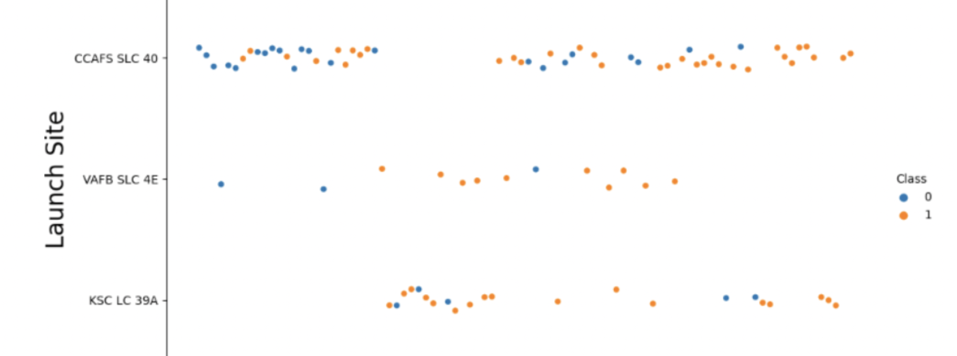
Flight Number vs. Launch Site
We concluded that the larger the flight amount at a launch site, the better the success rate at the launch site.
Blue = Fial, Orange = Success

Slide 19
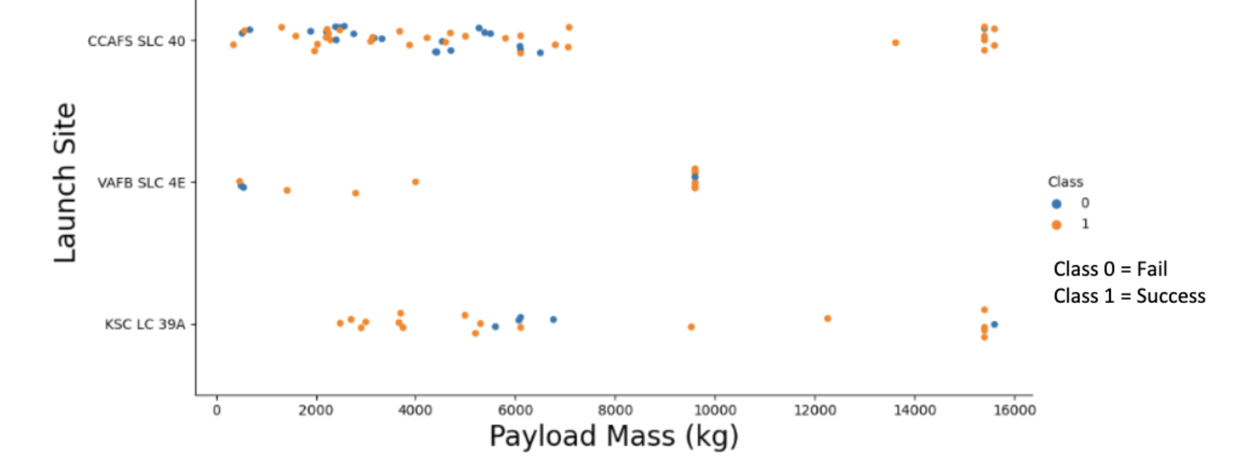
Payload vs. Launch Site
We found that the greater the payload mass for launch site CCAFS SLC 40, the higher the success rate

Slide 20
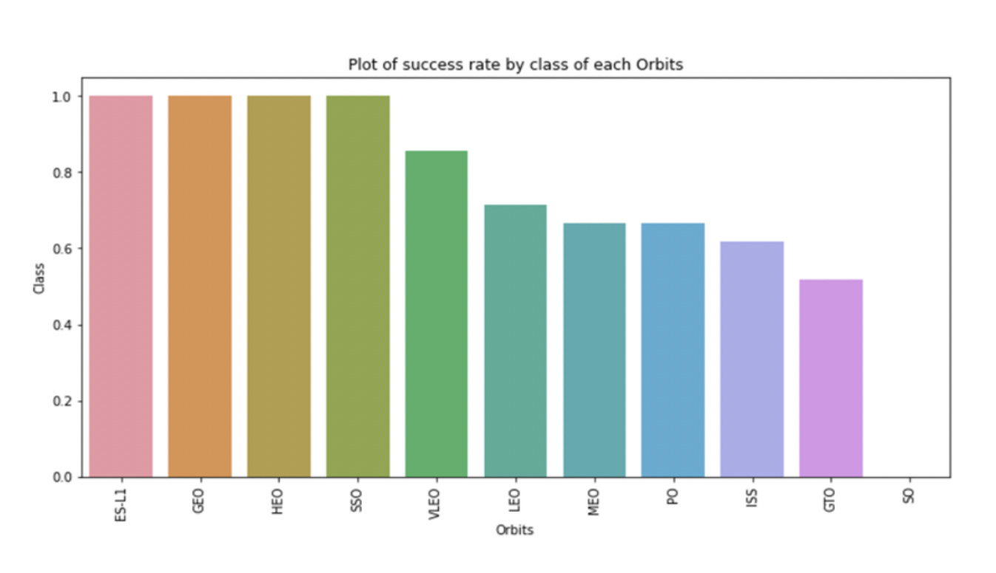
Success Rate vs. Orbit Type
From the bar chart, we notice that the ES-L1, GEO, HEO, and SSO had the highest success rate

Slide 21
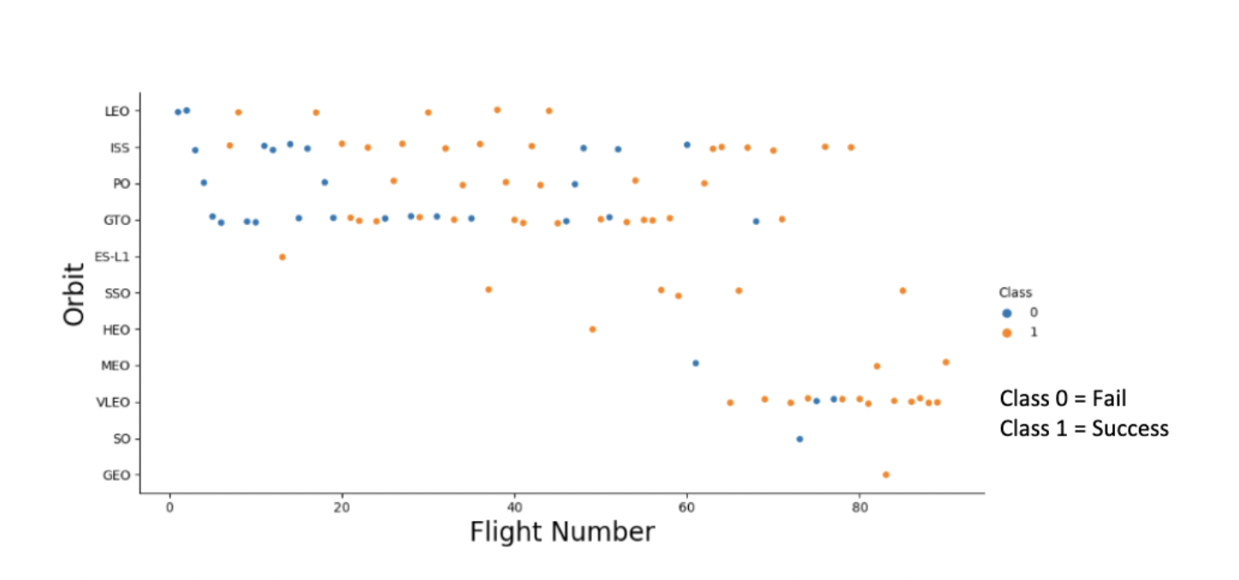
Flight Number vs. Orbit Type
This plot showcases how in the LEO orbit, there is a correlation between the flight number and success. However, the GTO orbit showcases no correlation for the flight number and orbit.

Slide 22
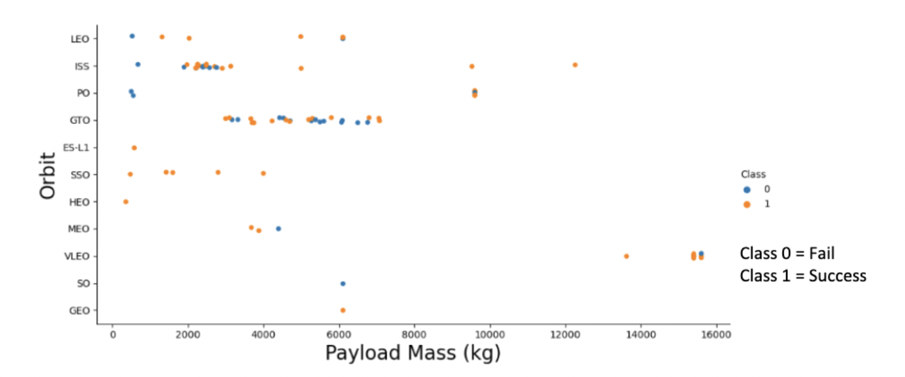
Payload vs. Orbit Type
This visualization shows how payloads are better with LEO, ISS and PO orbits. The GTO has mixed results and is inconclusive with the heavier payloads.

Slide 23
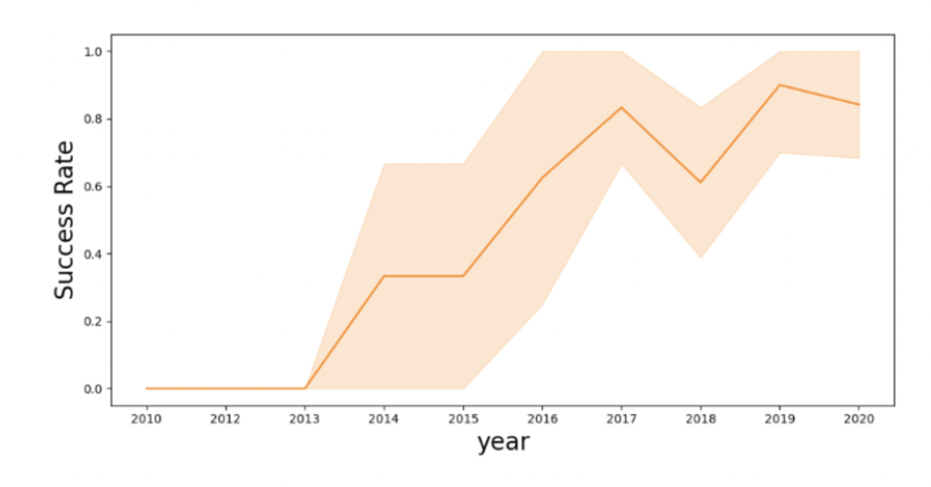
Launch Success Yearly Trend
Overall, the success rate has improved since 2013

Slide 24
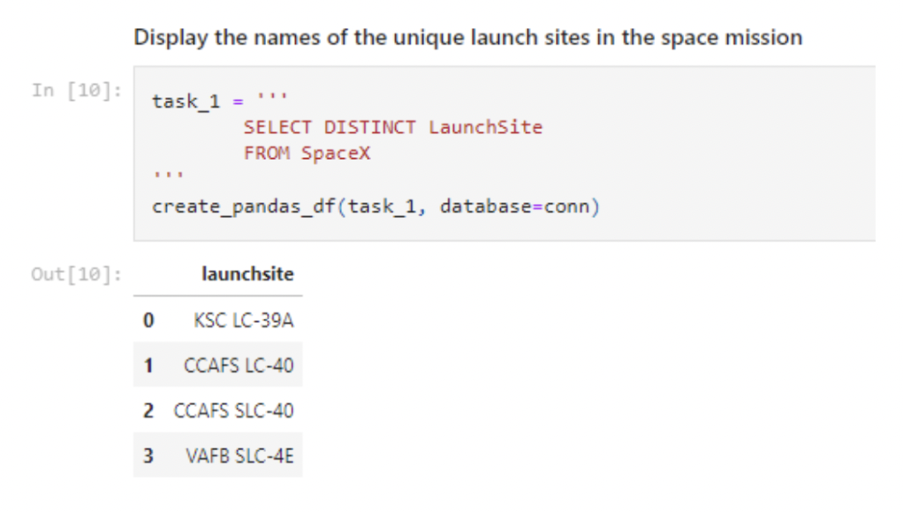
All Launch Site Names
We used the DISTINCT function to show the uniquelaunch site names from the SpaceX data

Slide 25
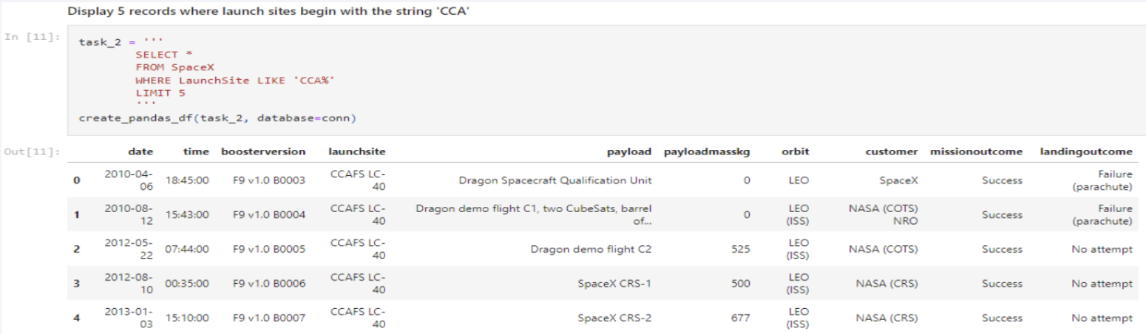
Launch Site Names Begin with 'CCA'
We used the query showcased to display the records where the site launch site names begin with ‘CCA’

Slide 26
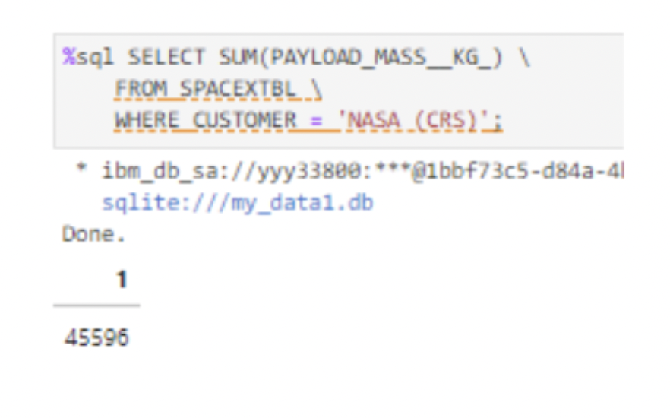
45,596 kg carried by boosters launched by NASA
Total Payload Mass

Slide 27
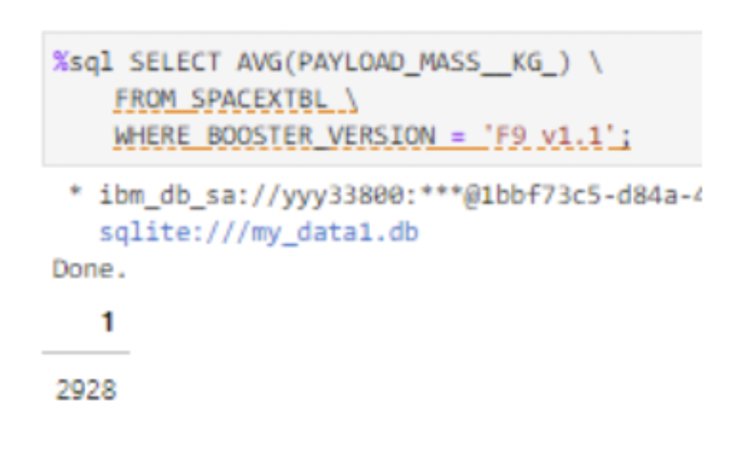
2.998 kg carried by booster version F9 v1.1
Average Payload Mass by F9 v1.1

Slide 28
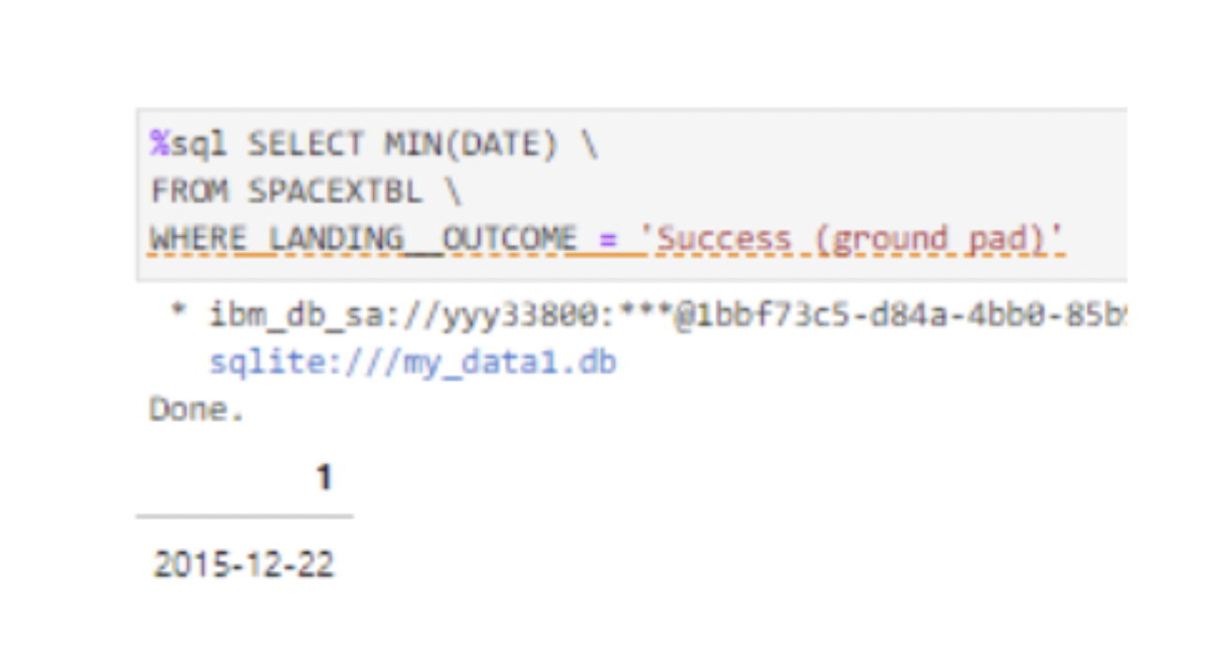
12/22/2015
First Successful Ground Landing Date

Slide 29
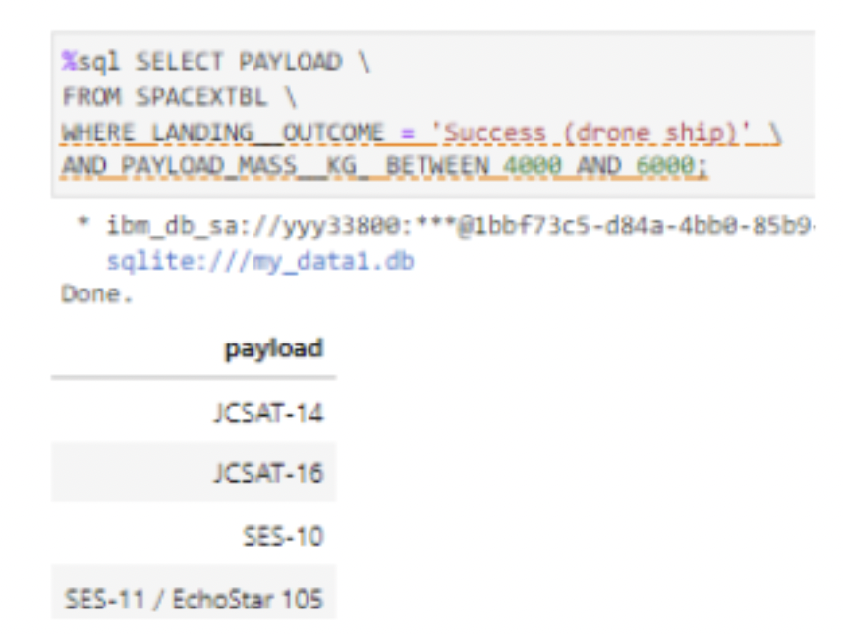
Successful Drone Ship Landing with Payload between 4000 and 6000
Booster Mass greater than 4,000 and less than 6,000
JSCAT-14
JSCAT-16
SES-10
SES-11/EchoStar 105

Slide 30
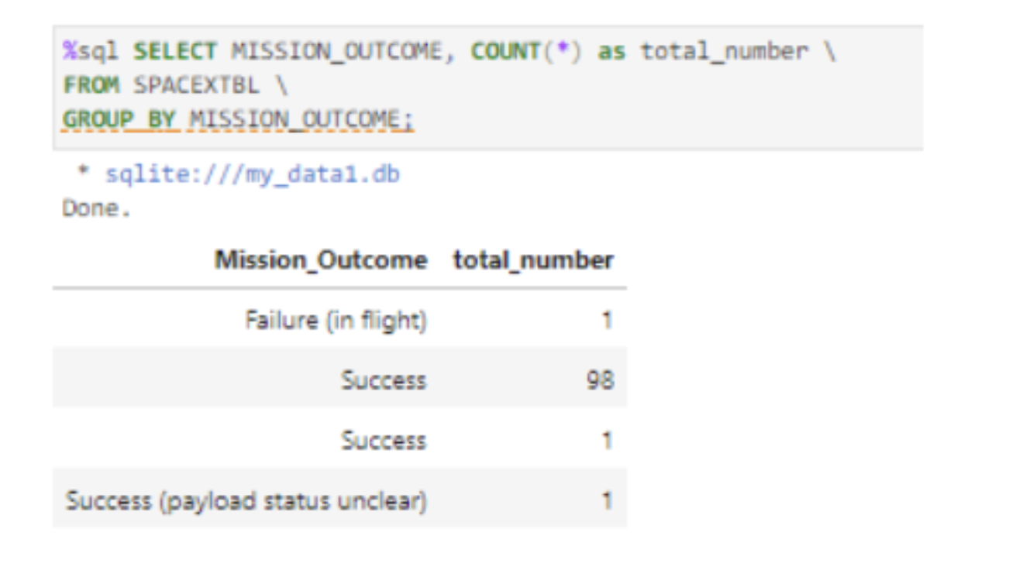
Total Number of Successful and Failure Mission Outcomes
1 Flight Failure
99 Successes
1 Success (payload status unclear)

Slide 31

Boosters Carried Maximum Payload
We determined the booster that have carried the maximum payload using a subquery in the WHERE clause and the MAX() function.

Slide 32

2015 Launch Records
We used a combination of WHERE, LIKE, AND, and BETWEEN to filter through the failed landing outcomes

Slide 33

Rank Landing Outcomes Between 2010-06-04 and 2017-03-20
We used the COUNT, WHERE and BETWEEN function to find landing outcomes between 2010-06-04 to 2010-03-20
We applied the GROUP BY and ORDER BY functions to group and sort the outcomes in descending order

Slide 34
Launch Sites and Proximities Analysis
Section 3

Slide 35
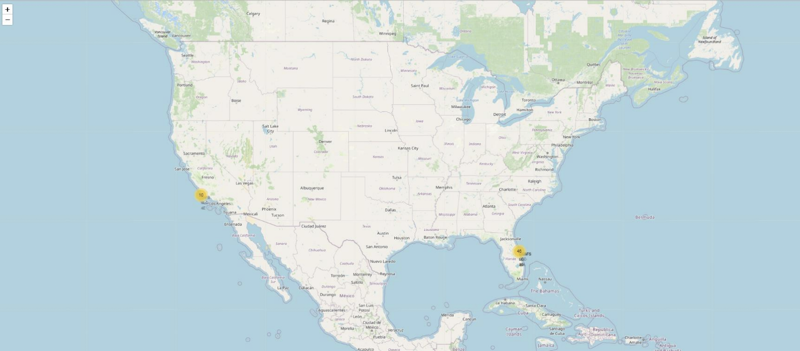
Launch Sites and Global Map Markers
Launch sites are in the United States and near the equator

Slide 36
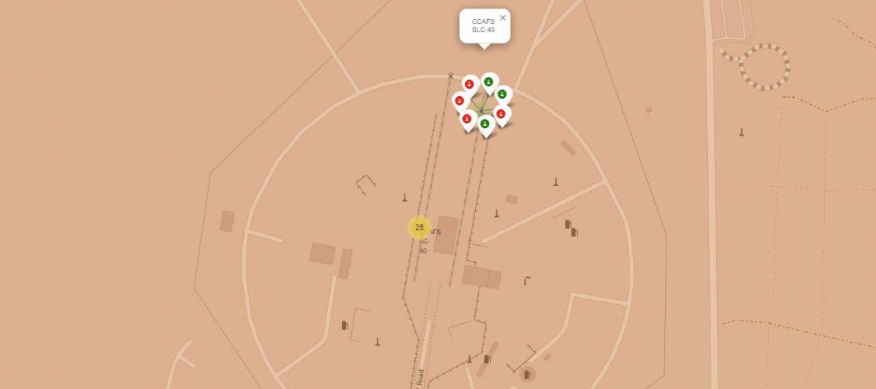
<Folium Map Screenshot 2>
Green = Successful Landing
Red = Failed Landing

Slide 37
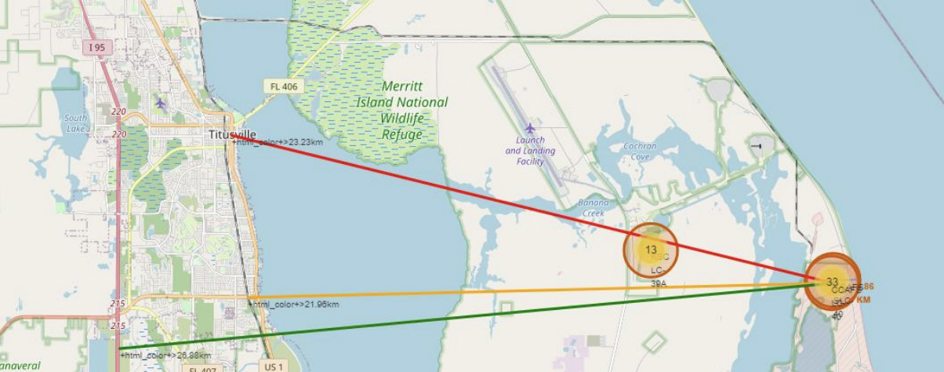
<Folium Map Screenshot 3>
Coasts: want to ensure that failed launches don’t destroy people or property
Transportation/Cities: need to be away from buildings, roads and people, to make sure the launch is safe and doesn’t harm others

Slide 38
Build a Dashboard with Plotly Dash
Section 4

Slide 39
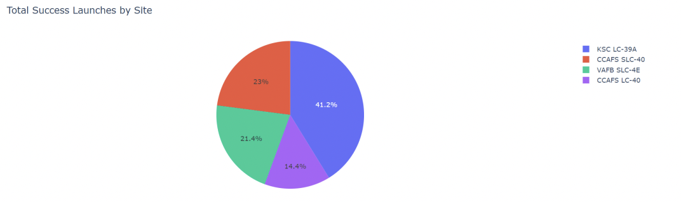
Success Rate of Each Launch Site
KSC LC-39A has the most successful launch rate

Slide 40
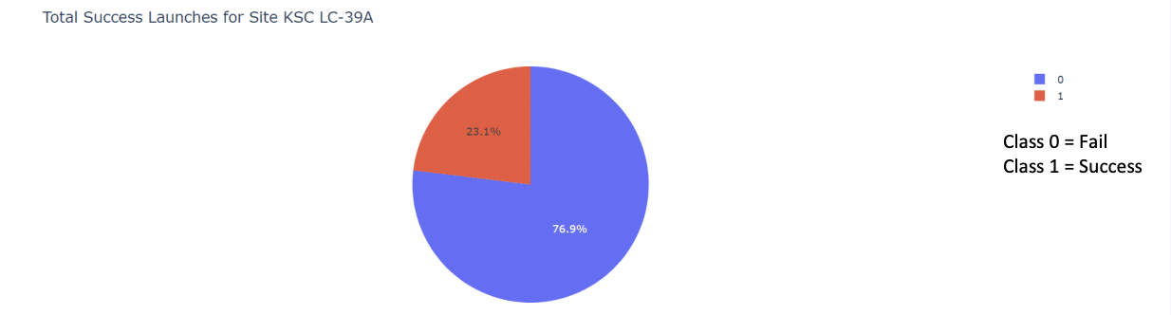
Launch Success of KSA LC-39A
KSA LC-39A had 10 successful launches and 3 failed launches
Success Rate: 76.9%

Slide 41
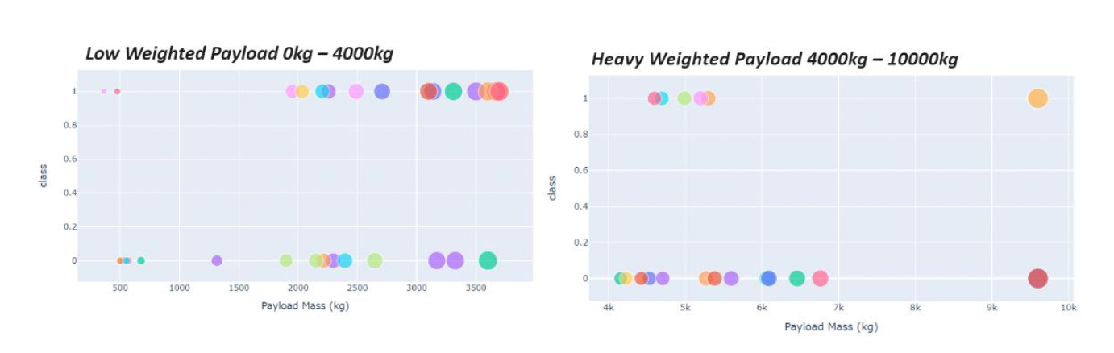
Pay Load v Launch Outcome Scatter Plot
The success for low weighted payloads is higher than the success for heavy weighted payloads

Slide 42
Predictive Analysis (Classification)
Section 5

Slide 43

The decision tree classifier has the highest accuracy.
Classification Accuracy

Slide 44

Confusion Matrix
The confusion matrices were all the same, showcasing the different classes and success rates. Although they all had a fault of showing false positives. It showed an unsuccessful landing as a successful landing, which is not good.

Slide 45
Conclusions
Launch success rates began to increase after 2013
Larger flights have a greater success rate at the launch site
The most successful orbits were ES-L1, GEO, HEO, SSO and VLEO
The KSC LC-39A had the most successful launches
The Decision Tree classifier was the best and most accurate Machine Learning algorithm

Slide 46
Thank you!

